Slide 1
Gillian and Vaughn’s Robotics Project

Slide 2
Challenges you faced
FINDING A COMMON TIME TO MEET
ADJUSTING THE PROGRAM TO DO EXACTLY WHAT WE WANTED TO DO

Slide 3
Roles of each team member
VAUGHN
Build requirements table
Create an algorithm
Create code to move the robot
Robot Testing
TEST TABLE
Sensor data
System Design Document
Set up GitHub Repository
Add all documents to GitHub
GILLIAN
Create code to move the robot
Robot Testing
Staffing Plan
Robot Video
Add all documents to GitHub
Build requirement signoff table
Develop a Flowchart

Slide 4
What have you learned about software engineering
Vaughn
Although the assignment may seem easy, there will be one hundred little things that can go wrong
Without extensive planning, these projects can get out of hand
Gillian
I learned that software engineering is within computer science and works with the design, development, testing, and maintenance of software applications.

Slide 5
What would you do differently?
Take more time to plan out what we are going to do beforehand
Setting deadlines earlier than the date due

Slide 6

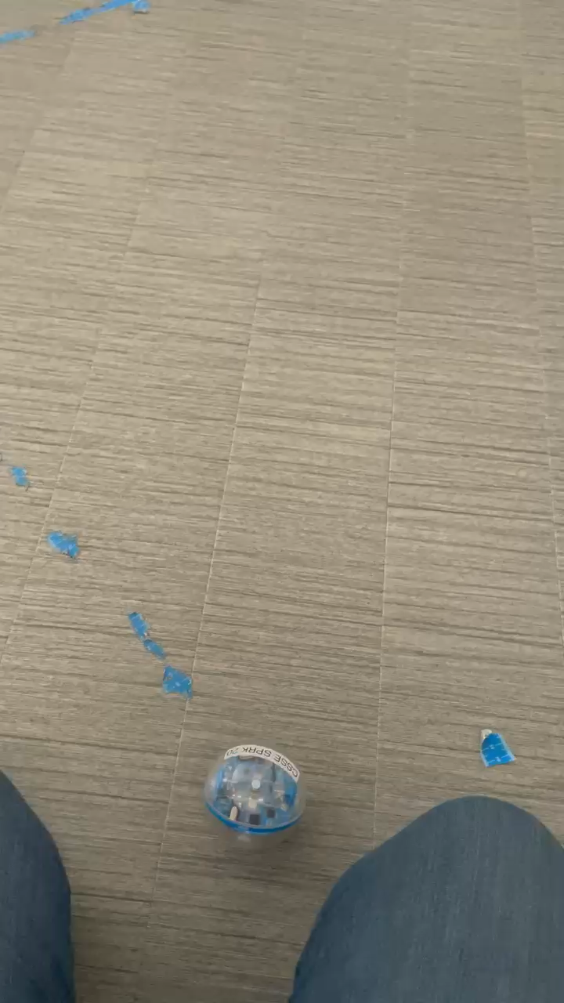
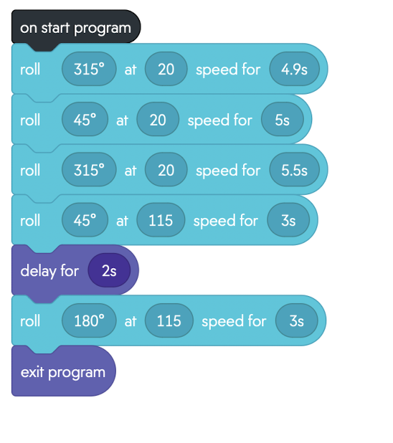
Sprint THREE: AGILITY

Slide 7
Thank you

